Slide 1
Let’s do some KNNs
Logan and Ishan

Slide 2
01
Project Goal

Slide 3
KNNs
Take a test instance
Sort all train instances by distance to it
Take the K closest ones
Majority vote for class
Predict!

Slide 4
KNNs - the special sauce
Take a test instance
Sort all train instances by distance to it
Take the K closest ones
Majority vote for class
Predict!
We can do something else here!

Slide 5
02
Specifics, Techniques

Slide 6

Our Versions:
Regular KNN (majority vote)
Weighted Averaging (vote but weighted by 1/frequency of class)
Weighted Distancing (weighted 1/distance)
Local Density Averaging
Ok, this one’s a little complex:
For each neighbor:
Look at all other train points within radius R
Count em up, get local density
Normalize local density between all the neighbors
Weight by this normalized value
All of em combined

Slide 7
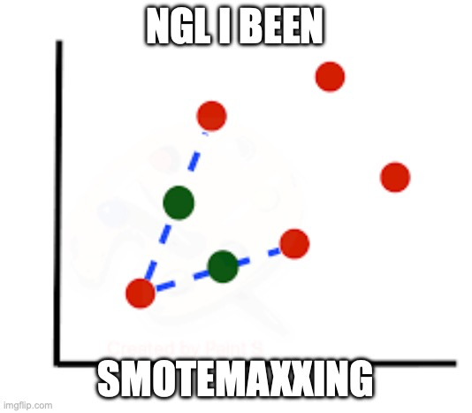
Preprocessing?
SMOTE

Slide 8

What is SMOTE?
Synthetic Minority Oversampling TEchnique
Basically, take minority class, choose a point, grab the K-nearest neighbors, and place a new synthetic point somewhere randomly on the line in between the neighbor and the point. Repeat until all classes have the same number of instances.

Slide 9

So, our categories:
Regular KNN
Weighted Averaging KNN
Weighted Distancing KNN
Local Density Averaging KNN
All Methods Combined KNN
Regular KNN with SMOTE
Weighted Averaging KNN with SMOTE
Weighted Distancing KNN with SMOTE
Local Density Averaging KNN with SMOTE
All Methods Combined KNN with SMOTE

Slide 10

How did we find the optimal K and R values?
Original plan was to search through them by trying a bunch
Problem: code takes a really long time to run
Solution: try a few, and hope we found the best one! (we’re pretty confident)
We selected K = 5, R = 30

Slide 11
03
The Dataset

Slide 12
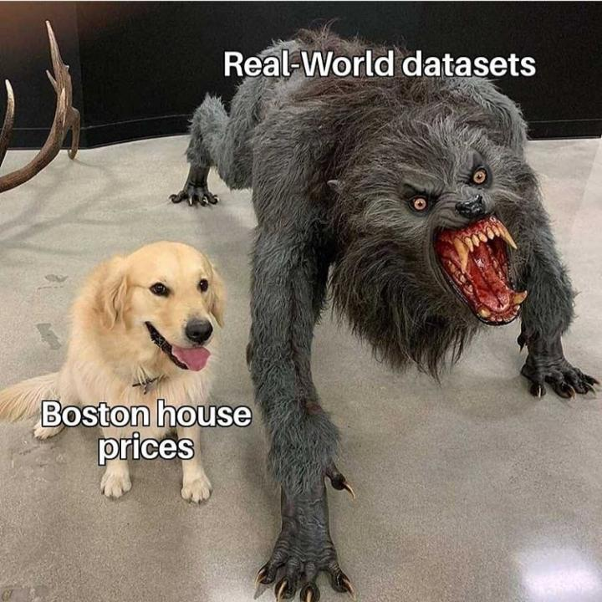
Goals for Dataset
Skewed class distribution
Noise (bad data that slipped through preprocessing)
Regular KNN can’t get above 75% accuracy

Slide 13
Synthetically-Generated Dataset
10 attributes
3 classes:
Majority class of 1105 instances, centered at (0,0…0) with a standard deviation of 3
Minority class of 409 instances, centered at (3,3…3) with a standard deviation of 7
Minority class of 386 instances, centered at (-3,-3…-3) with a standard deviation of 7
Started with blobs of 1000, 300, 300 instances, then added 300 instances of random noise (105 to majority class, 109 to first minority, 86 to second minority)

Slide 14
Train-Test Split, SMOTE
80% to train set, 20% to test set
1520 train instances
380 test instances
2652 train instances after SMOTE

Slide 15
04
The Results

Slide 16
(% accuracy) | Non-SMOTE | SMOTE
Regular KNN | 73.42% | 77.11%
Weighted Averaging | 76.58% | 77.11%
Weighted Distancing | 73.68% | 77.63%
Local Density Weighting | 74.47% | 77.37%
All Methods Combined | 75.26% | 76.58%

Slide 17

How about the minorities?
Not great, but improved
(% accuracy) | Class 1 | Class 2
Regular KNN | 38.96% | 56.10%
Weighted Averaging | 53.25% | 58.54%
Regular KNN (with SMOTE) | 54.55% | 64.63%
Weighted Distancing (SMOTE) | 55.84% | 64.63%
(16.88% increase!)
(8.53% increase!)

Slide 18
Results, Explained
Surprisingly, all the methods increased the accuracy!
SMOTE is really good!
After using SMOTE, the other methods aren’t as useful as there’s no class imbalance
(for example, weighted averaging now does nothing at all)
However, weighted distancing is still effective

Slide 19
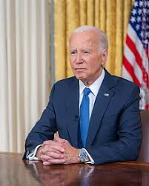
Why is the accuracy still not 100%?
These techniques aren’t perfect
But…
There is random noise in the data
The clusters overlap so it’s impossible to tell some apart
Given this, the improvement from ~73% to ~78% is pretty good!

Slide 20
05
Conclusion

Slide 21
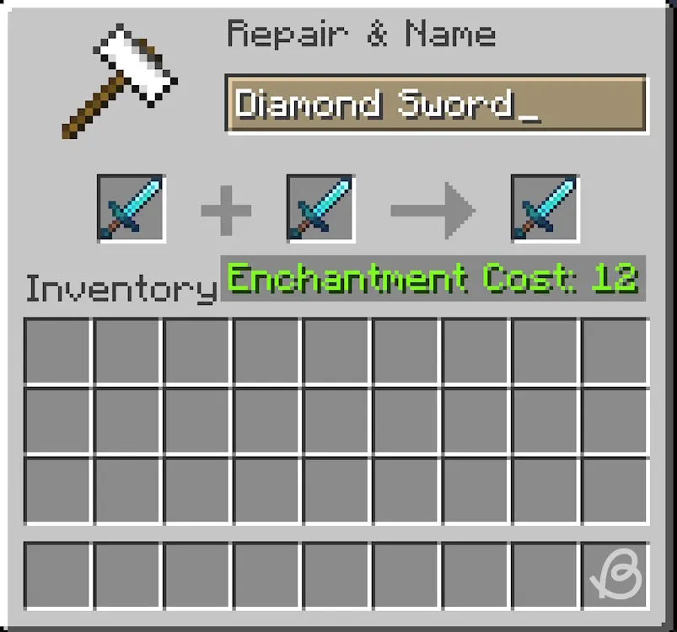
To Conclude:
KNNs do struggle with skewed and noisy data
Different weighting methods can help
SMOTE is very cool
If you combine all the methods, it doesn’t actually improve

Slide 22

Looking back…
Probably put too much noise in the dataset
Minority classes were 30%+ noise, so they really can’t get above 70% accuracy

Slide 23
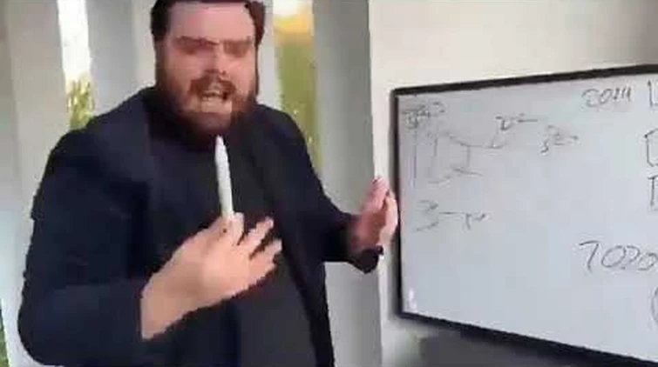
Looking forward…
With more computing resources:
More exhaustive search of K and R values
Multiple datasets
More advanced weighting/preprocessing methods

Slide 24

Any questions?

